Slide 1

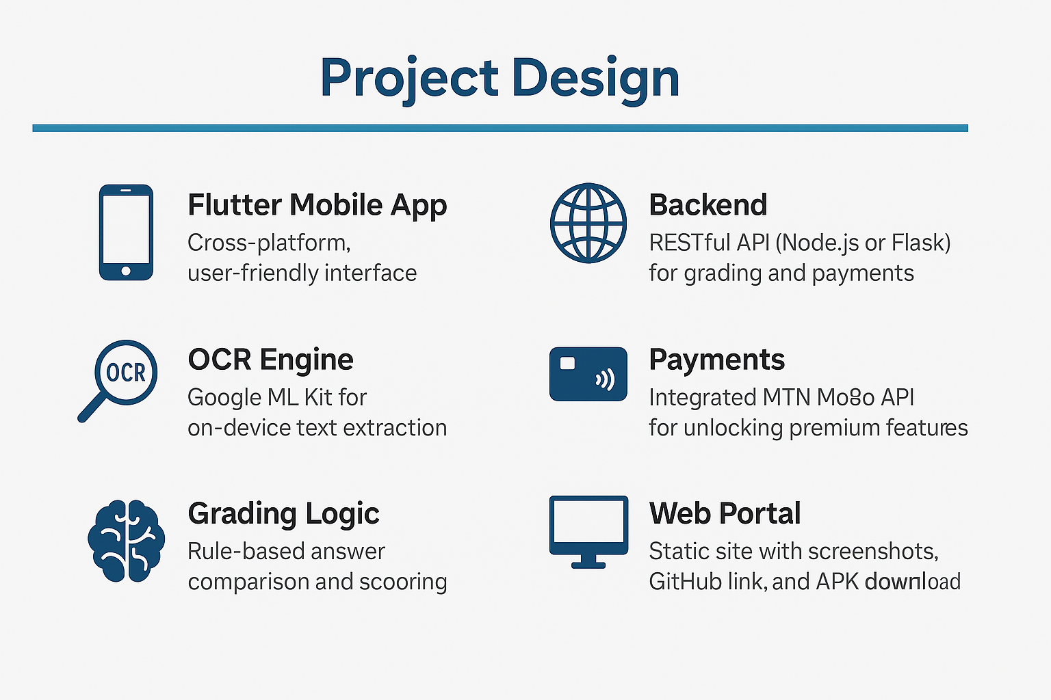
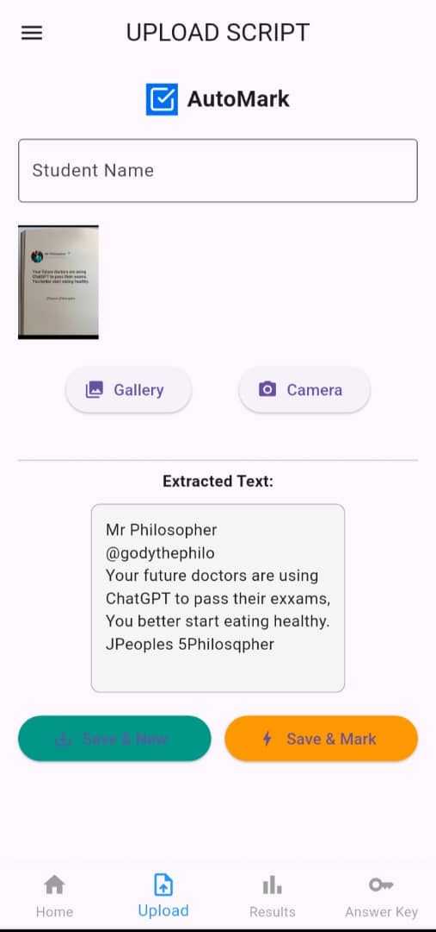
AutoMark – Smart Grading Assistant
Lyazi Patrick | Wanswa Drake | Ssekidde Jovan | Mila Samantha | Kato Adrian Mugerwa
Problems
Project Design
Results [Screenshots will be placed visually]
Manual grading is time-consuming and error-prone, especially with large class sizes. Educators face fatigue, inconsistency, and administrative overload. AutoMark automates this using OCR and mobile workflows.
Project Objectives
• Automate grading using OCR • Reduce human error • Support manual overrides • Enable result export and analytics • Integrate mobile money for premium features
Project Requirements
Results
• Upload & scan scripts • Extract answers using OCR • Input answer key • Automatic grading with feedback • Manual overrides & premium unlocks
Camera scan + OCR extraction Backend grading engine Manual override capability Premium features via MTN MoMo API
Home & Upload Screen
OCR Extraction
Manual Score Adjustment
Auto-Grading Results
Function: Users can capture or upload images of exam scripts.
Function: The app uses Google ML Kit to extract text from scanned scripts. The extracted answers are cleaned and formatted for grading.
Function: Users can override the score for any answer manually.
Function: The app compares student answers with the key, calculates the score, and displays it.
Awarding marks
Conclusion
AutoMark proves that OCR and automation can improve grading accuracy and reduce workload. It’s suitable for low-resource education environments. Results support feasibility and impact.
Target Users
Future Work
University lecturers
Capture or upload exam scripts
Institutions
Monitor grading efficiency
NGOs and exam administrators
Assist in scanning and uploading scripts
Set the answer key
Auto-grade scripts using OCR and logic
Manually adjust scores if needed
View, export, or share results
Use premium features (bulk grading, analytics) via MTN MoMo
Pay for premium features for staff (bulk grading, report downloads)
Collect standardized grading reports for institutional use
Review auto-graded results
Perform manual overrides on scores
Generate and share summaries with the lecturer
Handwriting OCR support User authentication & cloud sync iOS version development Subscription-based payments Export to PDF/Excel
File uploads
References
- developers.google.com/ml-kit - momodeveloper.mtn.com - flutter.dev - pages.github.com - developer.mozilla.org
Notes:
To change this poster, replace our sample content with your own. Or, if you'd rather start from a clean slate, press the New Slide button on the Home tab to insert a new page. Now enter your text and pictures in the empty placeholders. If you need more placeholders for titles, subtitles or body text, copy any of the existing placeholders, then drag the new one into place.

